Slide 1
Section 2.5 Absolute Value of Quadratic Functions And Solving Equations with ABS
i) Concept of Absolute Value functions
ii) Domain and Range of the ABS of a QF
iii) Graphing the absolute value of a QF
© Copyright all rights reserved to Homework depot: www.BCMath.ca

Slide 2
I) What is an Absolute Value Function
The ABS function measures the distance any value is from zero
Since distance is always positive, the ABS of any value will also be positive
When graphing the absolute value of a function, any point with a negative y-coordinate will be positive
If the point already had a positive y-coordinate, it will stay positive
© Copyright all rights reserved to Homework depot: www.BCMath.ca

Slide 3
II) Graphing an Absolute Value Function
First graph the function inside of the ABS function
Then reflect any part of the function under the x-axis to above the x-axis
Now state piece-wise function by restricting your domain with the x-intercept and indicate which side of the graph was reflected
y
First graph this line
5
The right side of the graph is under the x-axis, so reflect that side
4
3
Take the points with a negative Y-coordinates and change it to positive
2
1
To get the piece wise function, find the x-intercept
x
-4
-3
-2
-1
0
1
2
3
4
5
6
7
The right side was reflected, so place a negative sign and brackets around the equation
-1
-2
-3
Left
-4
Right
-5
© Copyright all rights reserved to Homework depot: www.BCMath.ca

Slide 4
Ex: Graph the Absolute Value of this function and state the piece wise function:
y
Take any part of the graph below the X-axis and vertically reflect it
5
Find the x-intercept
There are 3 parts to the piece wise function
Left
Middle
x
Right
-5
0
5
Note: Any number outside of the absolute value sign will be performed afterwards
First take the abs of the parabola
First shift the graph 4 units down
-5
Then shift the graph 4 units down
Then take the abs of the parabola
© Copyright All Rights Reserved Homework Depot www.BCMath.ca

Slide 5
iii) What is a Piece Wise Function:
A piece wise function splits the domain into several domains
Each domain can have a different function
Ex: Graph the following piece wise function
This function is used when “x” is less than -2
y
5
4
3
This function is usedwhen “x” is between -2 and 2
2
1
x
-4
-3
-2
-1
0
1
2
3
4
5
6
7
-1
-2
This function is used when “x” is greater than 2
-3
-4
-5

Slide 6
IV) Piece Wise for the ABS of a Quadratic Function
To write the piece-wise of a quadratic function, split the domain with the x-intercepts
If there are two X-intercepts, we will have 3 domains (Left/Middle/Right)
The function is the same for all three parts, but place a negative sign to the piece that was reflected over the x-axis
y
Ex: Write the Piece Wise function for the following function:
10
First find the x-intercepts of the parabola
X = –3 and x = 3
x
When we take the abs of this function, only the middle part is reflected
-5
0
5
Since the middle is reflected, put a negative sign in front of the function
-10

Slide 7
Graph each function, get the Piece wise function, and then find Domain and Range

Slide 8
Graph, Piece wise f(x), Domain and Range
y
5
0
x
-6
-4
-2
0
2
4
6
X: Intercept:
-5
Y: Intercept:
Domain:
Range:

Slide 9
Graph, state the PW function and find domain and range:
y
8
6
4
X: Intercept:
2
0
x
-4
-2
0
2
4
6
8
10
Y: Intercept:
Domain:
-2
Range:
-4
-6

Slide 10
V) Solving Absolute Value Equations
When solving abs equations, the value inside the abs sign can be both positive or negative
So when we are solving abs functions, we need to consider both cases
After we solve for “x” in both cases, plug it back into the equation to check for extraneous roots
Extraneous roots will occur when one side of the equation is positive and the other side is negative (NOT EQUAL!)

Slide 11
If we are to solve this equation graphically:
Now check for extraneous roots by plugging “x” back into the original equation
y
6
4
2
The solutions are: x= -8 & x= 2
x
-10
-8
-6
-4
-2
0
2
4
6
-2

Slide 12
Practice: Solve
No Solutions
There is only one solution at x = 0
Extraneous Root
There is only one solution at x = 1.666…

Slide 13
Practice: Graphical Solutions
y
y
6
6
4
4
2
2
x
x
-3
-2
-1
0
1
2
3
4
5
6
-3
-2
-1
0
1
2
3
4
5
6
-2
-2
Extraneous
Root
Only one intersection at x=0
Only one intersection at x=1.66

Slide 14
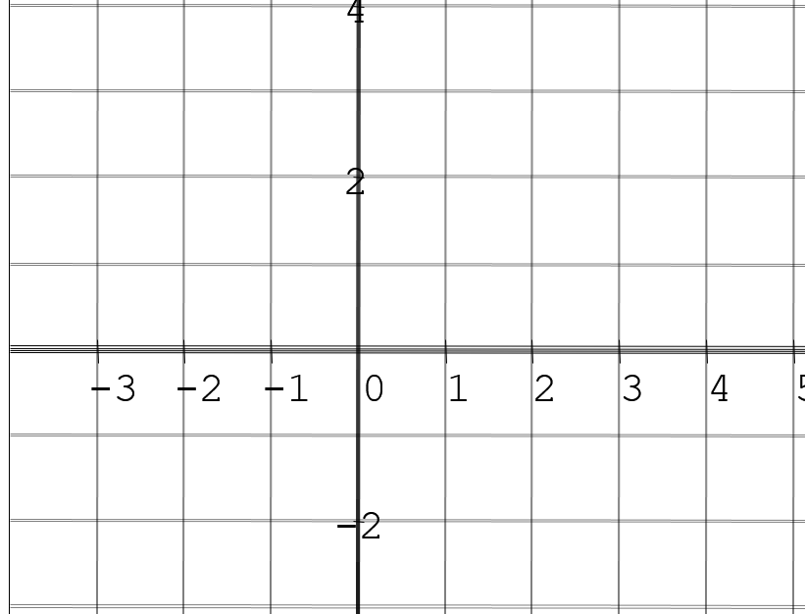
Extraneous Roots and Cases with Infinite Solutions:
Extraneous Roots occur b/c when you are solving algebraically, you will get all intersections before and after the vertical reflection
Ie: Suppose you are solving this equation:
We can see that there are TWO intersection points
Suppose we are now solving the ABS of the parabola, our equation now becomes:
Now, if we look at the abs graph, are there any intersection points?
The intersection points in the bottom are not actual answers! They are extraneous roots b/c they are not intersection points anymore….
Let’s look at another example, what if changed the right side to another equation
Extraneous root, NOT a Solution!
Intersection points (SOLUTIONS!)
How many intersection points and extraneous roots will there be?

Slide 15
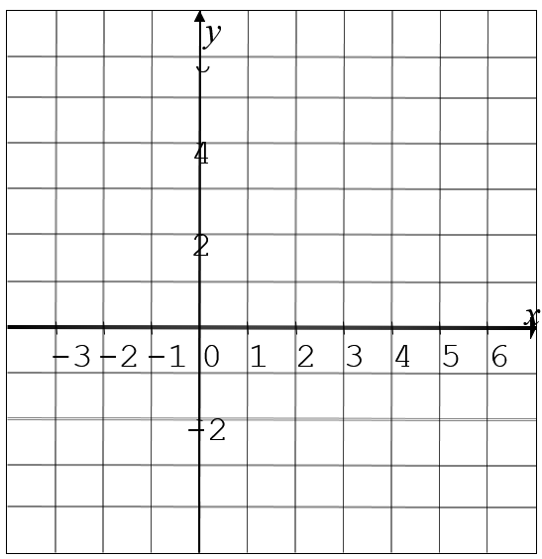
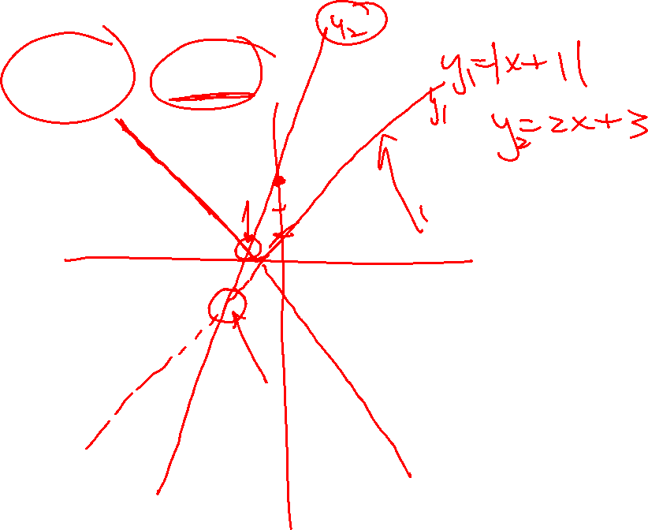
Best way to check for extraneous roots is to plug the answer to the “other side” of the equation
This side of the equation is always positive.
If you plug an answer to this side of the equation and get a negative value, then your answer should be an extraneous root
In contrast, cases with “infinite solutions” will occur when you have two different graphs overlapping each other
Graphically, you can see the two graphs overlap each other, this means that it will have infinite solutions in that part
Algebraically, you will have an equation with no variables and both sides are equal → Infinite solutions!!

Slide 16
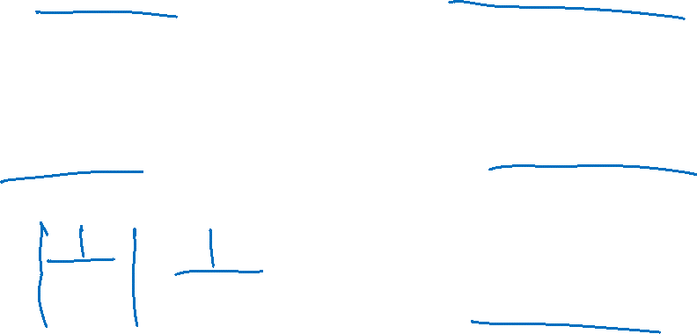
Practice: Solve each of the following

Slide 17
Solve:
Extraneous Root
Check:
No Solution

Slide 18
Solve:
Check:

Slide 19
Solve:
Check:

Slide 20
Solve:

Slide 21
Solve:
Check:

Slide 22
Lesson 5.4 Solving Equations with Two or MOre Absolute Values

Slide 23
How to Solve Equations With Multiple ABS
There are two ways to solve equations when there are multiple absolute values
First method: Algebraic Approach with Separate Cases
For each absolute value, there will be two possibilities: “positive” or “negative”
So if there are two ABS, we will have FOUR cases:
Solve all FOUR of these cases, get the answer, plug it back in to check if they are extraneous roots
If there are three ABS, you will then have 8 cases!
Case 1
Case 1
Case 2
Case 2
Case 3
Case 4
Case 3
Case 5
Case 6
Case 4
Case 7
Case 8

Slide 24
Since there are two absolute values, we need to consider all four cases with each abs value being positive or negative
For cases with solutions, check them by plugging it back in to the original equation
Case 1
Case 4
Case 2
Case 3
Case 4
No Solutions
Solution is good!
Solution is good!
No Solutions

Slide 25
Since there are two absolute values, we need to consider all four cases with each abs being positive or negative
Check each solution by plugging it back in
Therefore, the solutions to the system will be x = 2 and x = -1.333
Case 1
Case 2
Case 3
Case 4
Solution!
Extraneous
Extraneous
Solution!

Slide 26
Check each value of “x” by plugging it back into the equation
The solution to this equation is:
x=2.75 and x= –2.25

Slide 27
2nd Method: Graphical Approach
Treat the left side of the equation with all the ABS as a function
Find the x-intercepts from each absolute value, plug each one in separately to find the y-value of the equation [get the height of graph]
Connect these dots to get an idea of how this function will look:
y
8
4
Intersection point will also be on the RIGHT side!!
The intersection points will be on the LEFT side
x
-3
-2
-1
0
1
2
3
4
5
6
7
-2

Slide 28
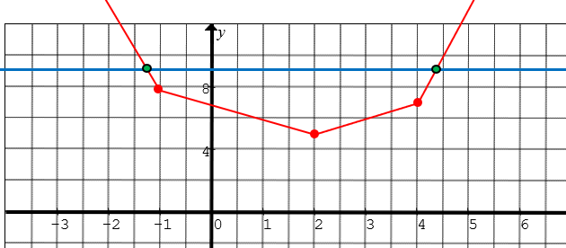
The second part of the method requires determining if the ABS in equation is either positive or negative
This depends on whether if the intersection points are either on the LEFT or RIGHT of the ABS
If the intersection is in this domain, then ALL three absolute values will be NEGATIVE, b/c it will all need to pointing the NEGATIVE side!!!

Slide 29
The second part of the method requires determining if the ABS in equation is either positive or negative
This depends on whether if the intersection points are either on the LEFT or RIGHT of the ABS
If the intersection is in this domain, the first one is positive and the other two are NEGATIVE. Use the arrows to decide if it is positive or negative!

Slide 30
The second part of the method requires determining if the ABS in equation is either positive or negative
This depends on whether if the intersection points are either on the LEFT or RIGHT of the ABS
If the intersection is in this domain, the first and second ABS are positive and the last one is NEGATIVE. Use the arrows to decide if it is positive or negative!

Slide 31
The second part of the method requires determining if the ABS in equation is either positive or negative
This depends on whether if the intersection points are either on the LEFT or RIGHT of the ABS
If the intersection is in this domain, All THREE ABS Values will be POSITIVE b/c they will point to the RIGHT!!!

Slide 32
Since the intersections are in the FAR left and Far right domains, then you will only need to solve these two equations:

Slide 33
Practice: Solve the following equations:

